Slide 1
Capstone Project Final Presentation - Clustering of Boroughs in Toronto and New York City to Identify Similar Boroughs
Karsten Kraak

Slide 2
Introduction
The borough and venues in the near vicinity can have a large effect on your experiences there
Scenario where a person is relocation from Toronto to NYC
The tool will be using Foursquare API venue data and use clustering techniques to highlight similar areas
Similar areas will then be displayed on a map of NYC and Toronto

Slide 3
Description of Data
The location data will be collected from 2 separate data sources
The Toronto data will be scraped from the following webpage: https://en.wikipedia.org/wiki/List_of_postal_codes_of_Canada:_M
This data will then be combined with the Location Data for NYC, which will be taken from the following:
https://cocl.us/new_york_dataset
Foursquare API will be used to explore 1000 venues within a 1000-metre radius of the centre of each borough
The top 10 most common venues in each borough will then be used to assign clusters to each borough using K-means clustering

Slide 4
Methodology
Combined data frame for NYC and Toronto Data was creating after scraping raw data from sources described
This data frame included Latitude and Longitude values for each borough
Foursquare API were then used to find the nearest 1000 venues in a 1000-metre radius of each borough location, and a data frame was then produced to reflect each venue returned by the query, its location and its category/venue type.
‘One-hot’ encoding method was used to summarise the venue results, and the mean of these values was taken
Top 10 venues in each borough was then listed by sorting the venue categories by their mean values. These top 10 venues were then inserted into a combined data frame to allow for a comparison between most common venues in each borough.
K-means clustering was then used to cluster all the boroughs based on the 10 most common venues using the data frame mentioned above
A data frame was produced to show the clusters and their most common venues for a side-by-side analysis in a tabular format. Finally, the application will produce two folium maps that will display similar boroughs in NYC and Toronto based on the results of the clustering.

Slide 5
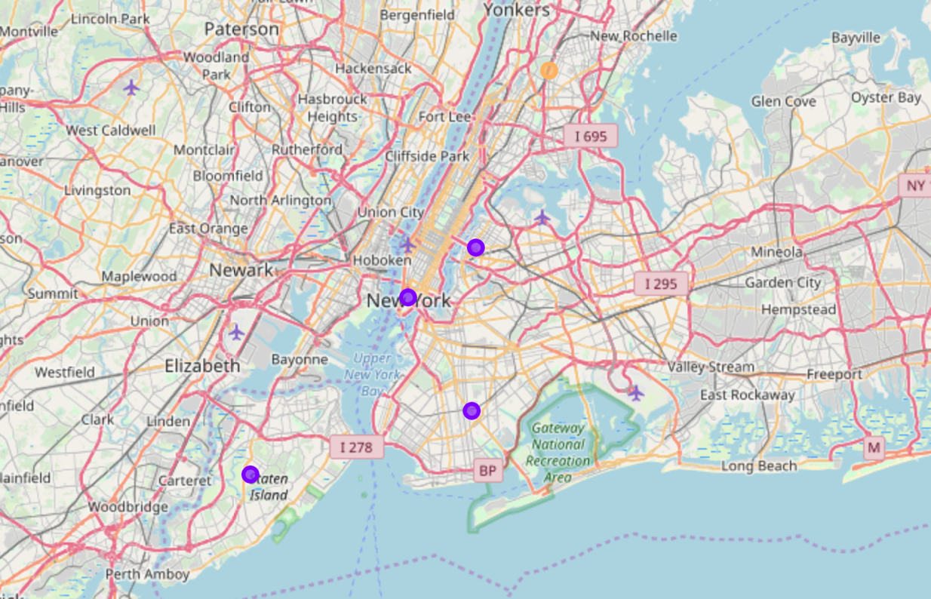
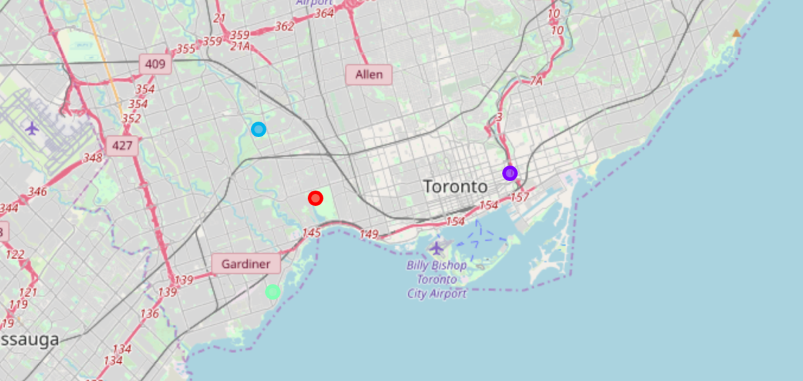
Results and Discussion (1 of 3)

Slide 6
Results and Discussion (2 of 3)
examining both maps simultaneously, it can be seen that only one of the boroughs in Toronto has been categorised to be in the same cluster (Cluster 1) as the boroughs in New York City – this borough was Downtown Toronto
Upon an examination of the location and terrain of Downtown Toronto it could be seen that it has similarities to the other boroughs in Cluster 1

Slide 7
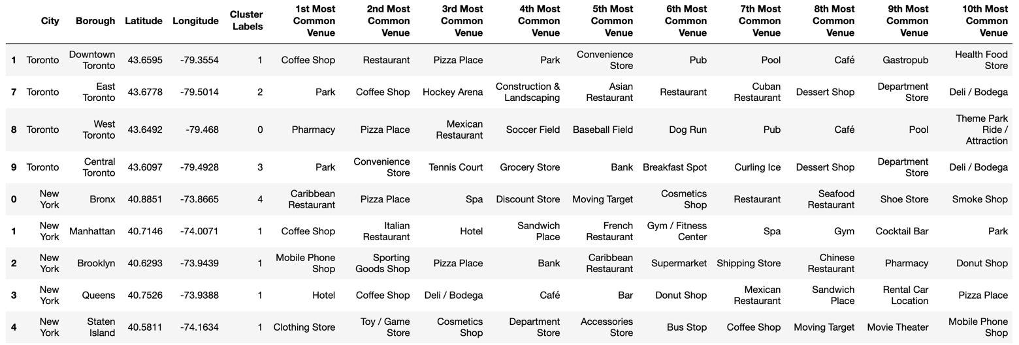
Results and Discussion (3 of 3)
Analysis of the figure revealed that it is unclear as to why the Boroughs have been clustered together and separately

Slide 8
Conclusions
Analysis of venue data would not be appropriate for comparing and clustering boroughs in separate cities, as only Downtown Toronto was placed in the same cluster as some of the boroughs in New York City
Size of each borough being too large, and therefore each borough is likely to have thousands of varying venues. It would be more valuable if a comparison of each neighbourhood were to be produced instead as this would allow for a more in-depth analysis and would show more accurate matches between matching neighbourhoods in clusters.
This could also show more variation between the clustering in New York City, and would allow for more localised clusters and a more in-depth analysis of these.

